Slide 1
Dorbom
SOYEON KANG, JUNGHYUN PARK Joseph Kim, Richard Lee

Slide 2
The Problem
People have difficulty understanding babies.
They are often unable to discern babies’ many needs and wants.
If only if there was a convenient way to understand a baby’s needs…

Slide 3
Solution
Introducing Dorbom!
BabyFace is a web application that will conveniently tell you your baby’s wants/mood based on his or her facial expression.

Slide 4
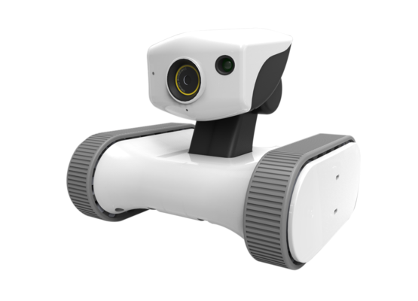
How it Works
Photos uploaded to server
Push to Dorbom
API Call
Baby’s Mood/Wants
Camera takes picture of baby’s facial expression
Trains model to recognize babies’ facial expressions
rather than babies’ personal identity

Slide 5
Business Model
Free Service (Consumer)
Advertising
Show ads of baby products based on the baby’s mood/needs.
No access to premium features.
Paid Service (Consumer)
Monthly Subscription Fee
No advertisements.
Allows access to premium features such as data analytics.
Ex. Breakdown of how often and when your baby is tired based on past data.
Enterprise
Sell data to companies that produce baby products.

Slide 6
Target Market
Parents with babies
Daycares
Babysitters
Companies that produce baby products

Slide 7
Future Implementations
Train on more photos
Set up machine learning analysis pipeline.
Separating training and validation sets.
Performance measurement – accuracy, f1 score, etc.
Transfer learning vs retraining entire network.
Add Audio Recognition to improve accuracy
Incorporate feedback functionality
Helps retrain model to provide more specialized and accurate responses.

